Slide 1
Interaction and Decoupling

Slide 2
Interaction
A control system is composed of several interacting control loops
The number of feasible alternative configuration of control loop is very large.

Slide 3
Non Interacting and decoupling Control
Important goal of multivariable control

Slide 4
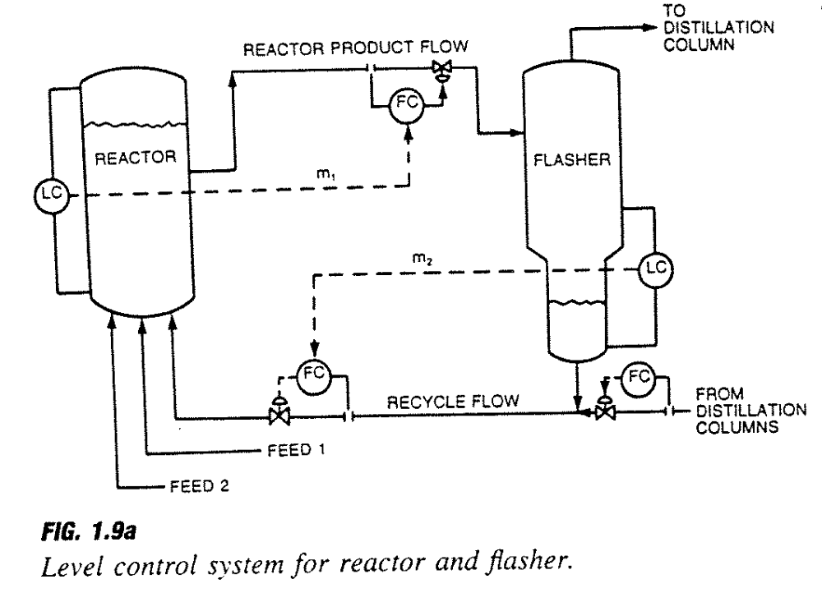
Example : Reactor and Flasher

Slide 5
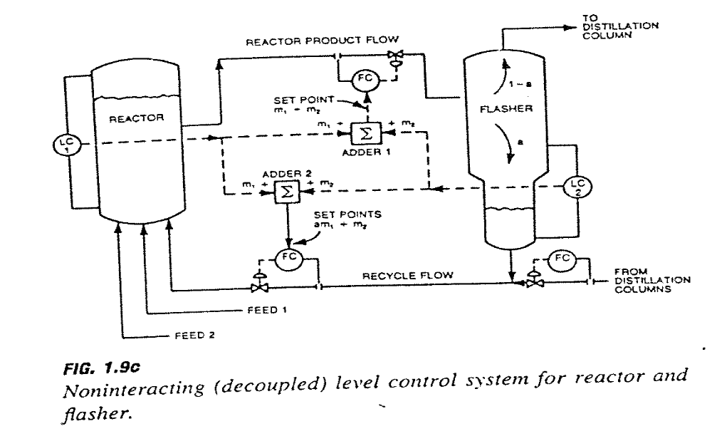
Non Interacting Level Control

Slide 6
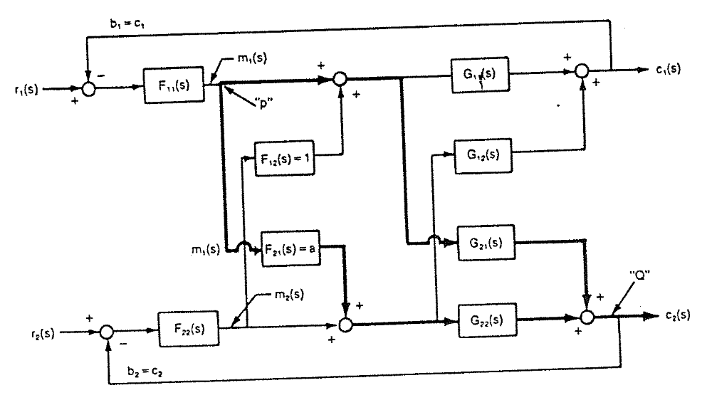
Generalization of non interacting Control

Slide 7

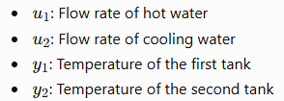
Questions
A two-input, two-output multivariable process has the following steady-state gain matrix:
Where

Slide 8
Answer the following:
Explain process interaction and identify the effect of the off-diagonal elements.
Calculate the Relative Gain Array (RGA) and suggest suitable input-output pairings.
Determine the steady-state decoupler matrix to reduce interaction between the two control loops
Draw a generalized block diagram of a two-input, two-output decoupled control system.

Slide 9

Relative Gain Array (RGA)
where о denotes element-by-element multiplication.

Slide 10
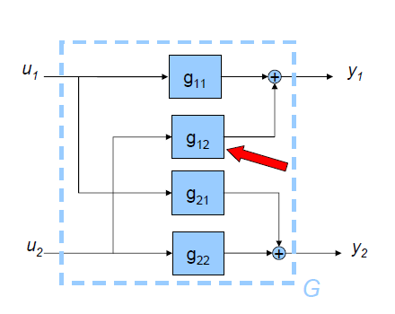
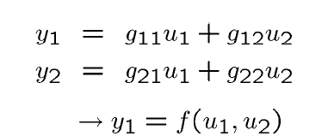
Open Loop

Slide 11
Close Loop

